Slide 1
URI vs URL vs URN
Dr. Binil Starly
James T. Ryan Professor
Edward P. Fitts Department of Industrial & Systems Engineering
Notes:
https://www.linkedin.com/learning/programming-foundations-databases-2/relational-databases-2?u=53565897

Slide 2
7
URI – Universal Resource Identifier
“ A compact sequence of characters that identifies an abstract or physical resource that provides a simple and extensible means of identifying a resource”
https://www.ncsu.edu
mailto:bstarly@ncsu.edu
Tel:+1-919-818-1515
ftp://binilimageserver/files/vacationtrip

Slide 3
7
URL – Universal Resource Locator
“ A subset of the URI that identifies a resource but also how to access that resource by providing an explicit method such as http or https or ftp ”
URI
https://www.ncsu.edu/home.html
URL
Resource

Slide 4
7
URL – Universal Resource Locator
URL | URI
URL is a subset of URI that specifies where a resource is exists and the mechanism for retrieving it. | A URI is a superset of URL that identifies a resource either by URL or URN (Uniform Resource Name) or both.
The main aim is to get the location or address of a resource | The main aim of URI is to find a resource and differentiate it from other resources using either name or location.
URL is used to locate only web pages on the world wide web | Used in HTML, XML and other files XSLT (Extensible Stylesheet Language Transformations) and more.
The scheme must be a protocol like HTTP, FTP, HTTPS, etc. | In URI, the scheme may be anything like a protocol, specification, name, etc.
Protocol information is given in the URL. | There is no protocol information given in URI.
Example of URL: https://ncsu.edu | Example of URI: urn:isbn:0-736-47557-3 or Example of URI: a UUID such as 000ad092-183e-424b-b7f7-605a5ac52244
All URLs can be URIs | Not all URIs are URLs since a URI can be a name instead of a locator.

Slide 5
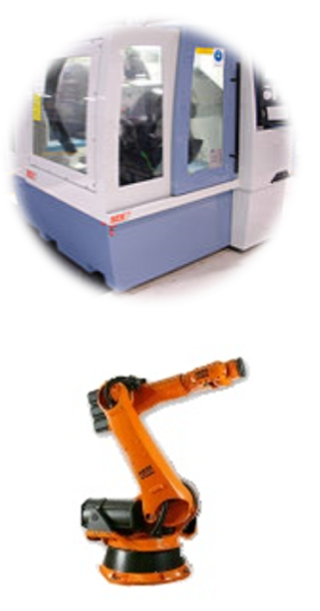
7
Factory Scenario
Each Machine Asset on the factory floor or even in an extended enterprise to have a URI.
This URI is critical to ensuring there is only one and only machine that can be identified by the URI

